Slide 1
EXPERIMENTAL DESIGN AND PANDAS

Slide 2
LEARNING OBJECTIVES
EXPERIMENTAL DESIGN AND PANDAS
Define a problem and types of data
Identify data set types
Define the data science workflow
Apply the data science workflow in the pandas context
Create an Jupyter Notebook to import, format, and clean using the Pandas library

Slide 3
COURSE
PRE-WORK

Slide 4
PRE-WORK REVIEW
Create and open an Jupyter Notebook
Complete the Python pre-work
Let’s take a look at the starter code from last lesson

Slide 5
OPENING
EXPERIMENTAL DESIGN AND PANDAS

Slide 6
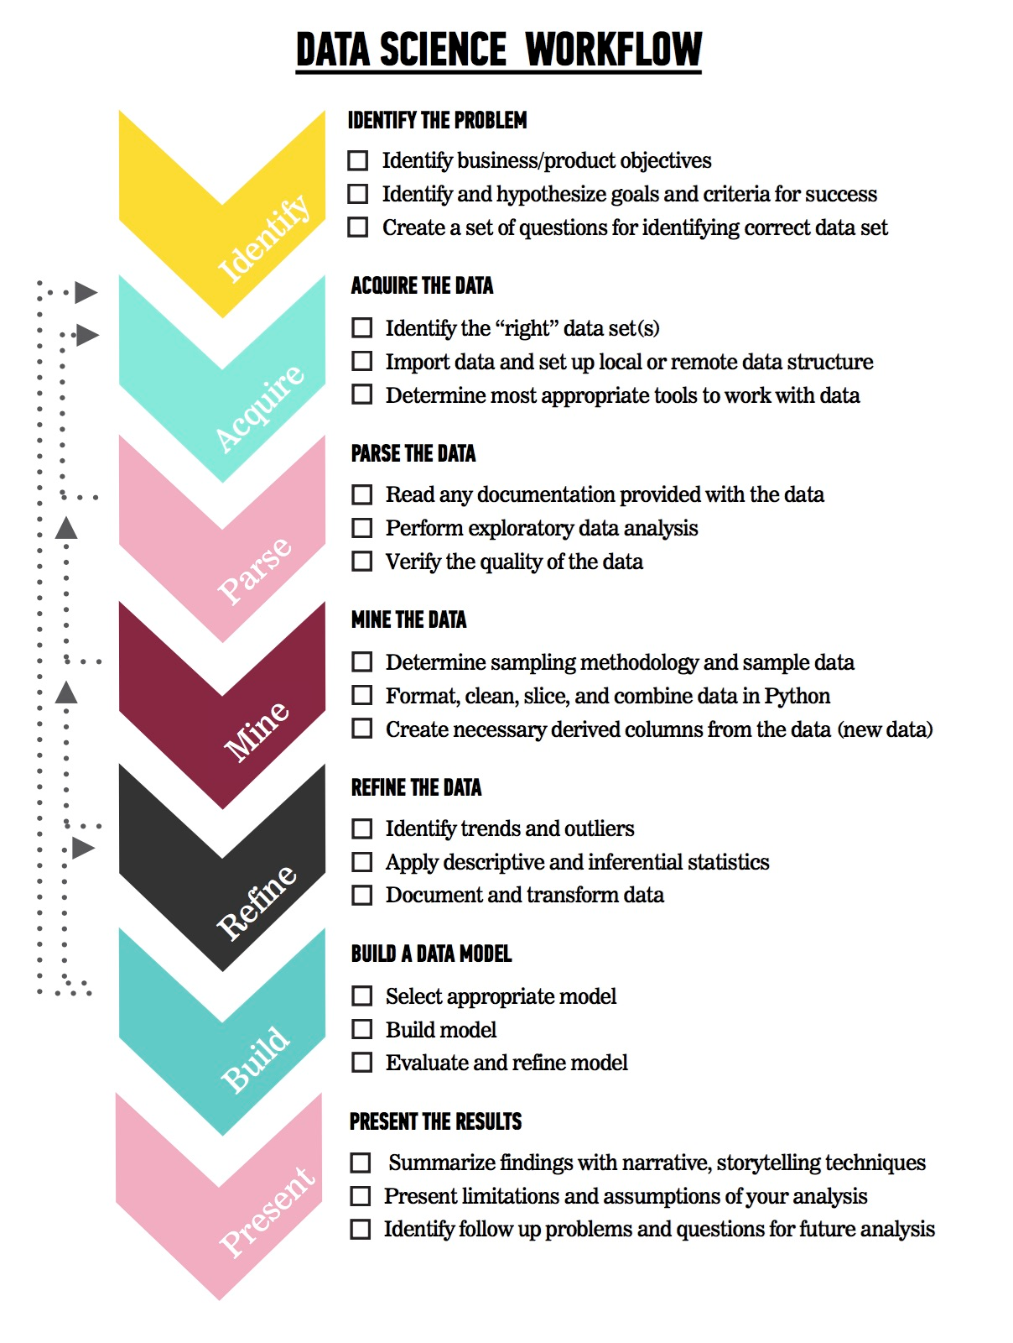
LET’S REVIEW THE DATA SCIENCE WORKFLOW
The steps:
Identify the problem
Acquire the data
Parse the data
Mine the data
Refine the data
Build a data model
Present the results

Slide 7
TODAY
We’re going to focus on steps 1-2 (Identify the Problem and Acquire the Data).
We’ll cover steps 3-5 in the next few classes

Slide 8
INTRODUCTION
ASKING A GOOD QUESTION

Slide 9
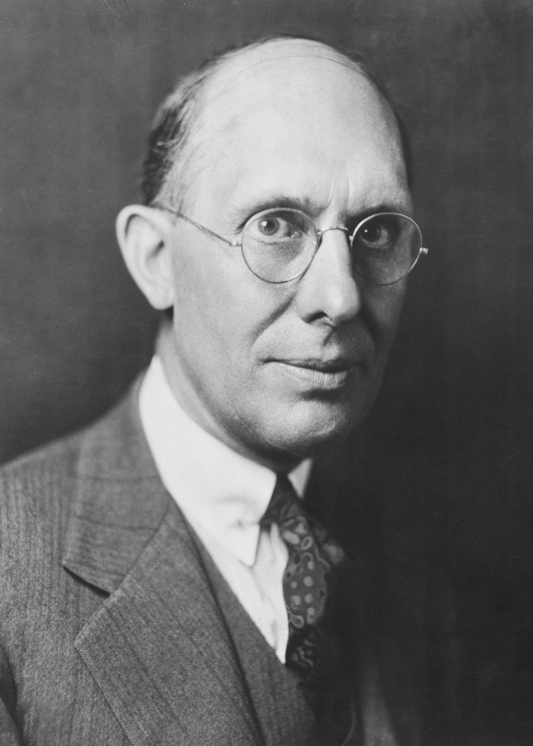
WHY DO WE NEED A GOOD QUESTION?
“A problem well stated is half solved.” - Charles Kettering (Possible Vampire)
Sets yourself up for success as you begin analysis
Establishes the basis for reproducibility
Enables collaboration through clear goals
But mostly, keeps YOU on track

Slide 10
WHAT IS A GOOD QUESTION?
Study design for analytics can use an adaption of the SMART framework.
S: Specific
M: Measurable
A: Attainable
R: Reproducible
T: Time-bound

Slide 11
WHAT IS A GOOD QUESTION?
Specific: The dataset and key variables are clearly defined.
Measurable: The type of analysis and major assumptions are articulated.
Attainable: Is the data available? Does it suit the needs of the study question? Will it be of good enough quality? Is there enough?
Reproducible: Another person (or future you) can read and understand exactly how your analysis is performed.
Time-bound: You clearly state the time period and population for which this analysis will pertain.

Slide 12
DEMO
CRAFTING AN ANALYSIS CAMPAIGN

Slide 13
EXAMPLE INTRODUCTORY STATEMENT
We will examine the association between thinking skill decline over time, localised brain cell damage (lesion) and ongoing diffuse brain cell death (atrophy). Collecting thinking style questionnaires and brain images from 100 people who have had a stroke, we will determine which is more linearly associated with decrease in thinking style ability over time - the lesion or the atrophy. The data will be collected over three sessions - one at baseline (within 3 days of the stroke), one 3 months after the stroke and a final session 12 months after.

Slide 14
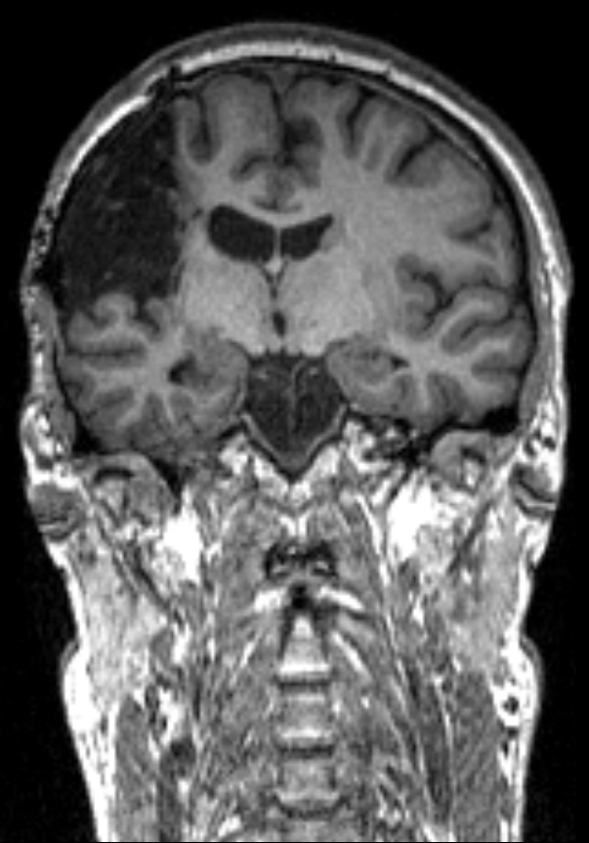
HYPOTHESIS
Increased atrophy will be associated with greater levels of decline in thinking style.

Slide 15
SPECIFIC
How data was collected:
3 sessions
What data was collected:
Thinking style questionnaires and brain scans
How data will be analyzed:
“which is more linearly associated“ - suggests linear regression
The specific hypothesis & direction of the expected associations:
As atrophy increases, thinking style decline increases.
(Kind confusing right? As decreases increase, another decrease increases too…)

Slide 16
MEASURABLE
Brain scans - physical (real) measure
Thinking style measures - Latent (hidden) measure

Slide 17
ATTAINABLE
Is it possible to test 100 people 3 times?
Are people going to drop out?
Is there enough funds? (brain scans cost $700 per hour…)
Study question is correlational in nature (easily examined).
Vs. Causational (much harder, typically not examined in data science)

Slide 18
REPRODUCIBLE
Does the introduction statement give any indication on reproducibility?
How can we make the collection and the analysis as reproducible as possible?

Slide 19
TIME BOUND
Sessions are 3 days, 3 months and 12 months after a stroke.

Slide 20
CONTEXT IS IMPORTANT
The previous example laid out research goals.
In a business setting, you will need to articulate business objectives.
Example: Success for the Netflix recommendation engine may be if 70% of customers over the age of 18 select a movie from the recommended queue during Q3 of 2015.
Regardless of setting, start your question with the SMART framework to help achieve your objectives.

Slide 21

ACTIVITY: KNOWLEDGE CHECK
ANSWER THE FOLLOWING QUESTIONS
EXERCISE
Which of the following uses the SMART framework? Why? What is missing?
I am looking to see if there is an association with number of passengers with carry on luggage and delayed take-off time.
Determine if the number of passengers on JetBlue, Delta and United domestic flights with carry-on luggage is associated with delayed take-off time using data from flightstats.com from January 2015- December 2015.

Slide 22
WHY DATA TYPES MATTER
Different data types have different limitations and strengths.
Certain types of analyses aren’t possible with certain data types.

Slide 23
CROSS-SECTIONAL DATA
All information is determined at the same time; all data comes from the same time period.
Issues: There is no distinction between exposure and outcome

Slide 24
CROSS-SECTIONAL DATA
Strengths
Often population based
Generalizability
Reduce cost compared to other types of data collection methods
Weaknesses
Separation of cause and effect may be difficult (or impossible)
Variables/cases with long duration are over-represented

Slide 25
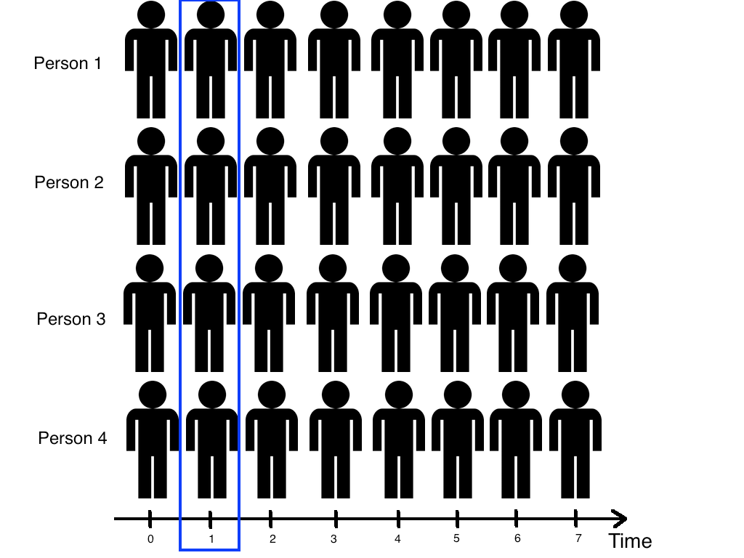
CROSS-SECTIONAL DATA

Slide 26
TIME SERIES/LONGITUDINAL DATA
The information is collected over a period of time
Strengths
Unambiguous temporal sequence - exposure precedes outcome
Multiple outcomes can be measured
Weaknesses
Expense
Takes a long time to collect data
Vulnerable to missing data

Slide 27
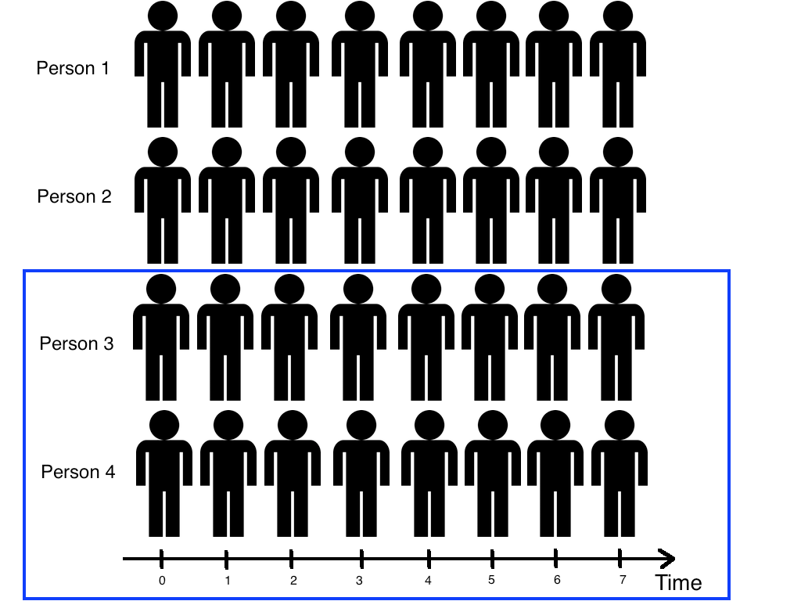
TIME SERIES/LONGITUDINAL DATA

Slide 28
ACTIVITY: KNOWLEDGE CHECK
ANSWER THE FOLLOWING QUESTIONS
EXERCISE
What type of data is the flight delay data?
Determine if we can examine the average delay for Alaska Airlines, Delta and Jet Blue in 2015 - Who performed better?
What about if the number of passengers on Alaska Airlines, Delta and Jet Blue domestic flights with carry-on luggage is associated with 15 minute delayed take-off time from January 2015- December 2015.

Slide 29
GUIDED PRACTICE
WRITE A RESEARCH QUESTION WITH RAW DATA

Slide 30
ACTIVITY: WRITE A RESEARCH QUESTION WITH RAW DATA
DIRECTIONS (10 minutes)
EXERCISE
Individually, look at the data from Kaggle’s Titanic competition and write a high quality research question.
Make sure you answer the following questions:
What type of data is this, cross-sectional or longitudinal?
What will we be measuring?
What is the SMART aim for this data?
When finished, let’s share our answers!

Slide 31
REVIEW
SMART

Slide 32
SMART REVIEW
The SMART framework covers the “Identify” step of the data science workflow.
Types of datasets: cross-sectional vs. time series/longitudinal
Questions?

Slide 33
INTRODUCTION
DATA SCIENCE WORKFLOW: ACQUIRE & PARSE

Slide 34
DATA SCIENCE WORKFLOW: ACQUIRE & PARSE
For the remainder of class, we’ll talk about steps 2 & 3 of the data science workflow: acquire and parse
We’ll be using Jupyter Notebook
First a demo, then a codealong
Finally, some hands on practice in a lab

Slide 35
DEMO
WALKTHROUGH ACQUIRE & PARSES WITH PANDAS

Slide 36
ACQUIRE
Where we determine if we have the “right” dataset for our problem
Questions to ask:
What type of data is it, cross-sectional or longitudinal?
How well was the data collected?
Is there much missing data?
Was the data collection instrument validated and reliable?
Is the dataset aggregated?
Do we need pre-aggregated data?

Slide 37
LOGISTICS OF ACQUIRING YOUR DATA
Data can be acquired through a variety of sources
Web (Google Analytics, HTML, XML)
File (CSV, XML, TXT, JSON)
Databases (SQL, NOSQL, etc)
Today, we’ll use a CSV (comma separated file)

Slide 38
PARSE: UNDERSTANDING YOUR DATA
You need to understand what you’re working with.
To better understand your data
Create or review the data dictionary
Perform exploratory surface analysis
Describe data structure and information being collected
Explore variables and data types

Slide 39
INTRO TO DATA DICTIONARIES AND DOCUMENTATION
Data dictionaries help judge the quality of the data.
They also help understand how it’s coded.
Does gender = 1 mean female or male?
Is the currency dollarydoos or euros?
Data dictionaries help identify any requirements, assumptions, and constraints of the data.
They make it easier to share data.

Slide 40
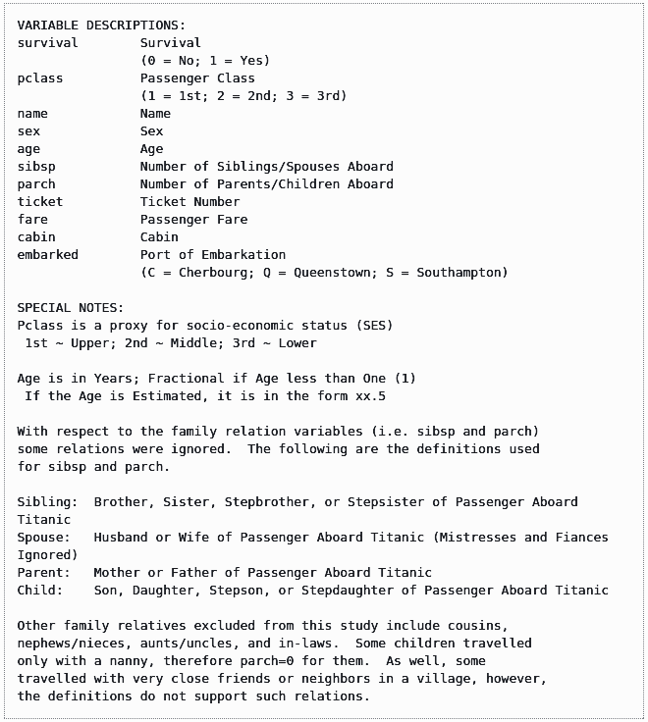
DATA DICTIONARY EXAMPLE: KAGGLE TITANIC DATA

Slide 41
CODEALONG
NUMPY AND PANDAS INTRO

Slide 42
NUMPY AND PANDAS INTRO
What are Numpy and Pandas?
Python packages
Pandas is built on Numpy.
Numpy uses arrays (lists) to do basic math and slice and index data.
Pandas uses a data structure called a Dataframe.
Dataframes are similar to Excel tables; they contain rows and columns.
A Pandas dataframe is similar to an R dataframe.

Slide 43
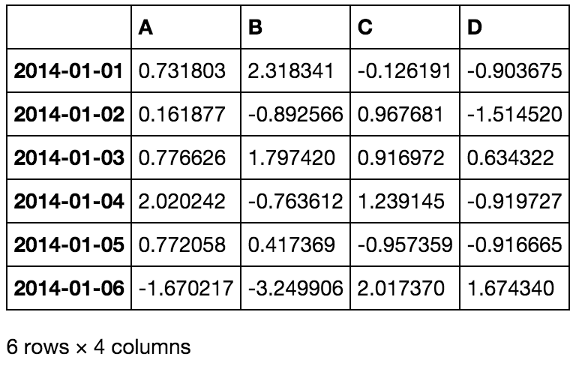
NUMPY AND PANDAS INTRO

Slide 44
NUMPY AND PANDAS INTRO
With these packages, you can select pieces of data, do basic operations, calculate summary statistics.
Follow along and code along as we learn about Numpy and Pandas.

Slide 45
DEMO
LAB WALKTHROUGH

Slide 46
LESSON 2 LAB WALKTHROUGH
By the end of the lab, you will:
Check basic features of the data
Select and filter data
Find basic stats like mean and max
Be introduced to function documentation

Slide 47
CONCLUSION
TOPIC REVIEW

Slide 48
REVIEW
Let’s go through the lab. Any questions?
Today, we’ve talked about
Defining a problem
Types of data
Acquiring and parsing data
Using Pandas

Slide 49
COURSE
BEFORE NEXT CLASS

Slide 50
BEFORE NEXT CLASS
Project: Unit 1 (we’ll go over it now)
Due WEDNEDAY
Bookmark and look over https://chrisalbon.com/ (great resource for DS in Python).

